Slide 1


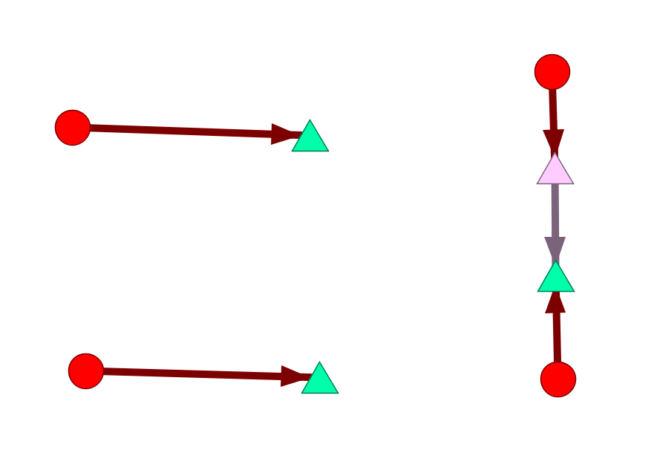
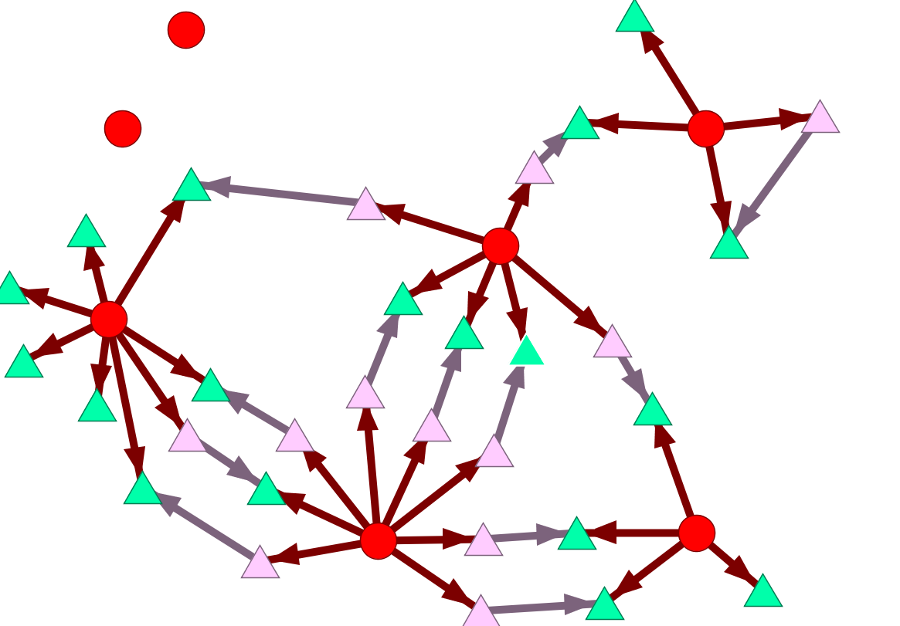


Using Digital Trace Data to Generate Autism Support Team Networks
Chris Friedman, Elizabeth McGhee Hassrick PhD, Sarah Vejnoska, Aubyn Stahmer PhD, David Mandel PhD, Tristram Smith PhD, Peter Mundy PhD, and Connie Kasari PhD
Background
Analysis
Few online communication tools for teams working with children with autism have been developed.
There are no standard measures of team interaction on digital interfaces and no studies have investigated their effects on collaboration.
Measurement of interactions will provide new knowledge about the impact of digital interfaces on care coordination and outcomes.
The data provided a clear picture of real time, actual communication of teams.
Using R, data from these teams were used to build hover reports, describing communication and activity of those teams.
We computed average counts of different types of interaction (e.g. posting a link to the team), as well as the average number of roles present on each team.
Objectives
Summary and Conclusion
Demonstrate measurement of networks of communication and resource sharing from electronic activity of team members
Examine how electronic communication reports can support team interactions.
Online tools present an opportunity for teams providing support to children with autism spectrum disorder to communicate and share resources and knowledge. Using the methods presented here, researchers and other entities can hover over communication in these online tools to measure actual collaboration within these teams to both measure them and to provide feedback that can better focus or guide future intervention.
Methods
Sample Descriptives
We asked autism support teams to use a social networking application designed to facilitate communication between teachers and parents
Team members could use the app to create and share calendar events, links, documents, pictures, and resources that work for the child.
Teams used the tool during the implementation of two multi-site interventions:
A school transition support intervention implemented before, during, and after the child’s transition between schools
A parent support and education intervention implemented post diagnosis for families without services.
Data was collected from the application and transformed using R to describe activity and communication between each of the teams
We developed a method to map digital social networks to study team dynamics on digital interfaces.
These reports were then given to site administrators to help them understand communication between participants
.
Table 1. Sample Description (n = 10)
 | M | SD
Team Size | 6.40 | 3.03
# of Events Posted | 0.49 | 0.55
# of Links Posted | 0.42 | 0.50
# of Comments Made | 0.69 | 0.52
Team Role Configuration
# of Clinical Staff | 0.80 | 1.48
# of Educational Provider | 1.20 | 1.23
# of Parent | 1.00 | 0.00
# of Peer Supporter | 0.40 | 0.52
# of Research Staff | 2.40 | 1.78
# of Specialist | 0.10 | 0.32
# of Transition Providers | 0.50 | 0.53
Exemplar Networks
Example 1: Few supporters with moderate network engagement
Example 2: Many supporters with higher network engagement
.
Team Member
Post
Comment
*This project is supported by the Health Resources and Services Administration (HRSA) of the U.S. Department of Health and Human Services (HHS) under grant number UA3MC11055-07, Autism Intervention Research Networks, with total costs $1,999,997. This information or content and conclusions are those of the author and should not be construed as the official position or policy of, nor should any endorsements be inferred by HRSA, HHS or the U.S. Government. Social network analytical support was provided by an NIH Social Networks and Health Fellowship training grant (R25HD079352).

